Slide 1
Angular 17
Lesson 11—HTTP, Promises, and Observables

Slide 2

Understand working with RxJS
Understand Angular 17 interaction with HTTP Get
Describe the process of sending data to the server
Explain the difference between Promises and Observables

Slide 3

Reactive Extensions (Rx)
The Rx is a library for composing asynchronous and event-based programs using observable sequence and LINQ-style query operator.

Slide 4
Why Observables?
The main purpose of using Observables is to observe the behavior of a variable.
It is important as a variable changes only when its state is changed by updating a value or assigning a new value.
The reactive approach allows variables to develop a history of evolving change, which is asynchronously updated to the values of other points of data.

Slide 5
Anatomy of an Observable
01
Observables follow the Observer pattern.
02
A piece of state (the Observable) is watched by one or more Observers; the observers react as the observable changes over time.
03
At a low level, the Observable acts as an event emitter.
04
The Observable sends a stream of events to subjects that have subscribed to it.

Slide 6
Observable-Collection
An Observable-Collection is a dynamic collection of objects of a given type.
Regular Collection
1 2 3 4 ….
foreach (var obj) in collection){
}
Observable
1 2 3 4 ….
function(newData){
}

Slide 7
Example
Consider capturing the mouse movements in a browser window.
let mouse;
document.onmousemove = (e) => mouse = [e.pageX, e.pageY];
Imperative way
Reactive way
When you receive an event that the mouse has moved, you must reassign the mouse to the updated coordinates.
The state of mouse is discrete; each reassignment overrides the previous one by removing any continuous connection.

Slide 8
Example
let mouse = document.onmousemove.subscribe()
Imperative way
Reactive way
The mouse will be assigned only once, and when the value is received, it will be stored in a stream of continuous activity.
The values captured by the mouse are stored in a FIFO queue.

Slide 9
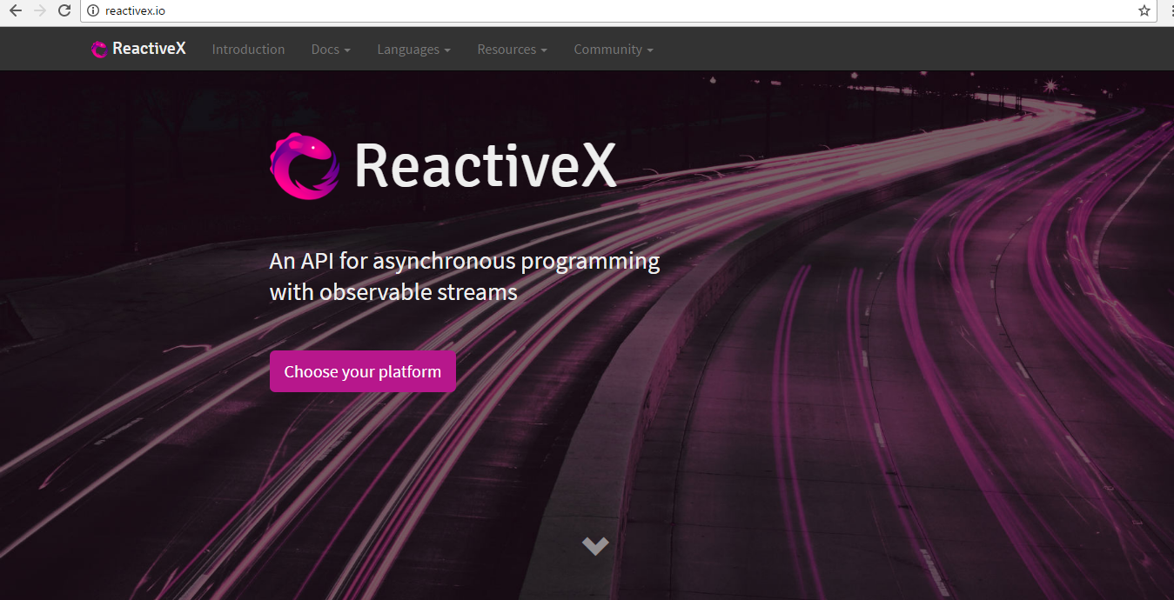
ReactiveX
Rx library helps you to avoid callback hell and make use of observable-based system to deal with asynchronous calls.

Slide 10
Problem
This is known as callback hell; without ReactiveX library, async call becomes complex.
>_
training@localhost:~
@Component({
selector: ‘my-app’,
template:’
<input id=“search” type=“text” class=“form-control” placeholder=“search”> ‘
})
export class AppComponent {
constructor() {
var debounded = _.debounce(function() {
var url=https://api.spotify.com/v1/search?type=artist8g= + term;
$.getJSON(url, function(artists){
console.log(artists);
});
}, 400);
$(“#search”).keyup(function(e){
var text = e.target.value;
if (text.length < 3)
return;

Slide 11
Solution with ReactiveX Library
This approach helps you use RxJS functions to keep code simple and free from callback.
>_
training@localhost:~
<input type= “text” id=“search” class=“form form-control”/>
.
})
export class App7Component implements OnInit{
constructor( ) {
}
ngOnInit() :any {
var keyups= Observable.fromEvent(jquery(“#search”), “keyup”)
.map(e =>e.target.value)
.filter(text =>text.length >=3)
.debounceTime(400)
. .distinctUntilChanged()
.flatMap(searchterm => {
var url=https://api.spotify.com/v1/search?type=artist8g= + SearchTerm;)
var promise=jQuery.getJSON(url);
return Observable.fromPromise(promise);
});

Slide 12
Angular 17 HTTP and Observables
Later, callbacks were considered a bad practice, and promises had to be used.
Earlier, callbacks were preferred for handling XHR.
Now, observables, rather than promises, can be used to handle HTTP requests.

Slide 13
Using HTTP in Angular 17
Http is a separate model in Angular 17 available under the ‘@angular/Http’ package.
To use HTTP in Angular 17:
01
Import the ‘@angular/Http’ package and inject it into the component/service
02
Use “get” method to send an HTTP request and subscribe to the response asynchronously
03
When the response arrives, map it to the desired object and display the result

Slide 14
Setting up Angular 17/HTTP
To use the new HTTP module in the components, you have to import HTTP. Then, inject it via Dependency Injection in the constructor.
Here is an example:
>_
training@localhost:~
import { Injectable } from '@angular/core';
import { Http } from '@angular/http';
@Injectable()
export class MyComponent {
constructor(private http: Http) { }
}

Slide 15
Advantage and Disadvantage of Template-Driven Forms
Advantage
Disadvantage
It is simple and can build a large range of forms.
The logic of form validation cannot be unit tested. The only way to test this logic is to run an end-to-end test with a browser, for example, using a browser like PhantomJS.

Slide 16
HTTP Module During Bootstrap
Besides making changes to components using HTTP, you also need to include a HTTP Module during bootstrap.
>_
training@localhost:~
import { platformBrowserDynamic } from '@angular/platform-browser-dynamic';
import { BrowserModule } from '@angular/platform-browser';
import { HttpModule } from '@angular/http';
import { AppComponent } from './app.component';
@NgModule({
imports: [ BrowserModule, HttpModule ],
declarations: [ AppComponent ],
bootstrap: [ AppComponent ]
})
class AppModule { }
platformBrowserDynamic().bootstrapModule(AppModule);

Slide 17


Lab—Demo
START LAB

Slide 18

HTTP Post
In Angular 17, http.post is used to send data to the server.
Example:
You receive the username and password from a form the user submitted.
You call authenticate to log in the user.
Once the user is logged in, you proceed to store the token by including it in following requests.
http.post(url: string, body: string, options?: RequestOptionsArgs)
: Observable<Response>

Slide 19
HTTP Post Signature
http.post returns an Observable and uses map to extract the JSON object from the response and to subscribe.
This will set up your stream as soon as it emits the result.
Finally, call this.store token with the corresponding user token.

Slide 20
Difference between $http and Angular 17 HTTP
Angular 17 HTTP returns an Observable, whereas $http returns a Promise ($q module). This allows more flexiblility and powerful RxJS operators like switchMap, retry, buffer, debounce, merge, or zip.
Observables improve readability and maintenance of the application as they can respond gracefully to more complex scenarios involving multiple emitted values opposed to only a one-off single value.

Slide 21
Observables vs. Promises
When used with HTTP, both implementations provide an easy API for handling requests, but there are some key differences that make Observables a superior alternative:
Observables
Promises
Observables accept more than one value.
Observables can be cancelled. This provides better control when working with in-flow of values from a stream.
Promises accept only one value unless you compose multiple promises (Example: $q.all).
Promises can’t be cancelled.

Slide 22
Lab—Demo
START LAB

Slide 23
RxJS library is used for composing asynchronous and event-based programs with the help of observable sequences and LINQ-style query operators in JavaScript.
In Angular 17, http.get method creates a simple HTTP Service; it sends an HTTP request and subscribes to the response asynchronously.
http.post is used to send data to the server in Angular 17.
When used with HTTP, both Observables and Promises provide an easy API for handling requests, but Observables accept more than one value and are cancellable, and this makes them better than Promises.

Slide 25
RxJS library is based on _______design pattern.
1
Observer
Model-driven
Template
Factory

Slide 26
RxJS library is based on _______design pattern.
1
Observer
Model-driven
Template
Factory
a.
RxJS library is based on observer design pattern.

Slide 27
Which operator is NOT a part of ReactiveX library?
2
Map
Flatmap
Debounce
Data

Slide 28
Which operator is NOT a part of ReactiveX library?
2
Map
Flatmap
Debounce
Data
d.
Data operator is not a part of ReactiveX library.

Slide 29
Which methods belong to HTTP?
3
get
Post
Put
delete
All of the above

Slide 30
Which methods belong to HTTP?
3
get
Post
Put
delete
All of the above
e.
All these methods belong to HTTP.

